Slide 1
Procedure for executing a XML,XML DTD,Schema file

Slide 2
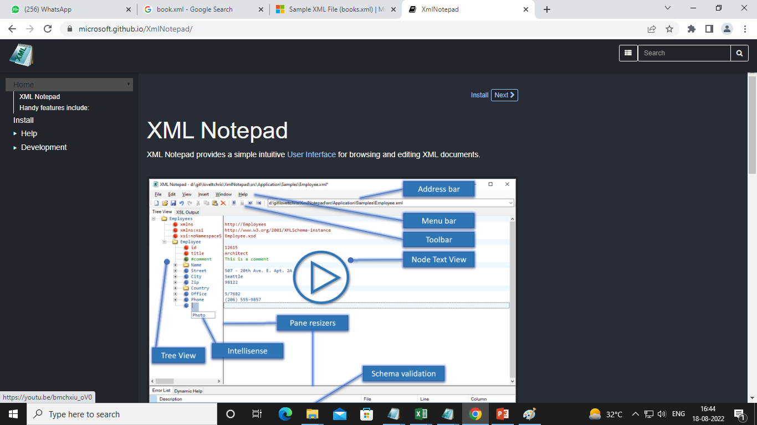
Parsers
XML Notepad

Slide 3
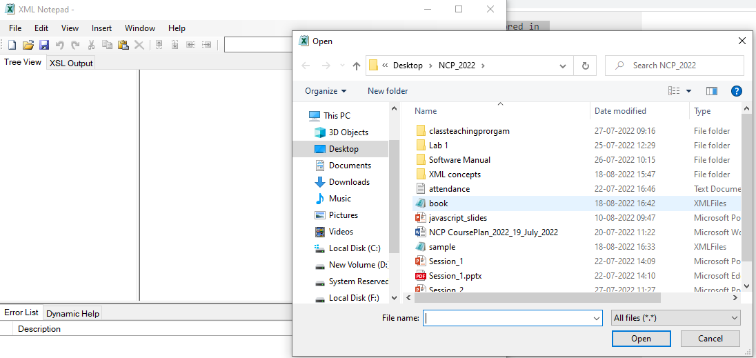
XML file
Book.xml

Slide 4
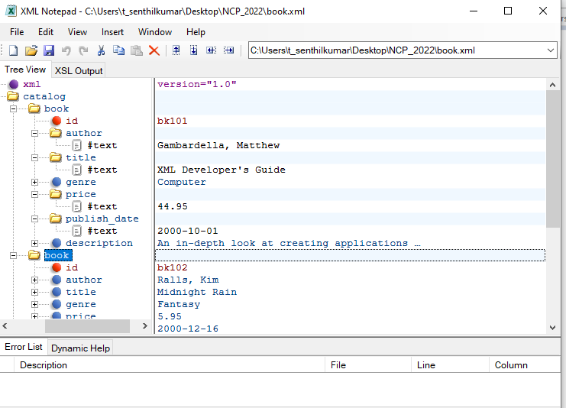

Slide 5
Types of DTD
Internal DTD
External DTD
Sample

Slide 6
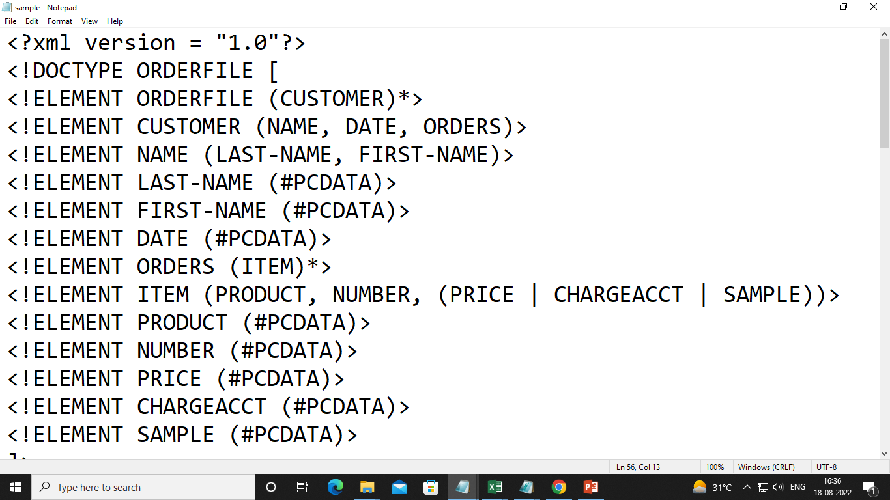

Slide 7
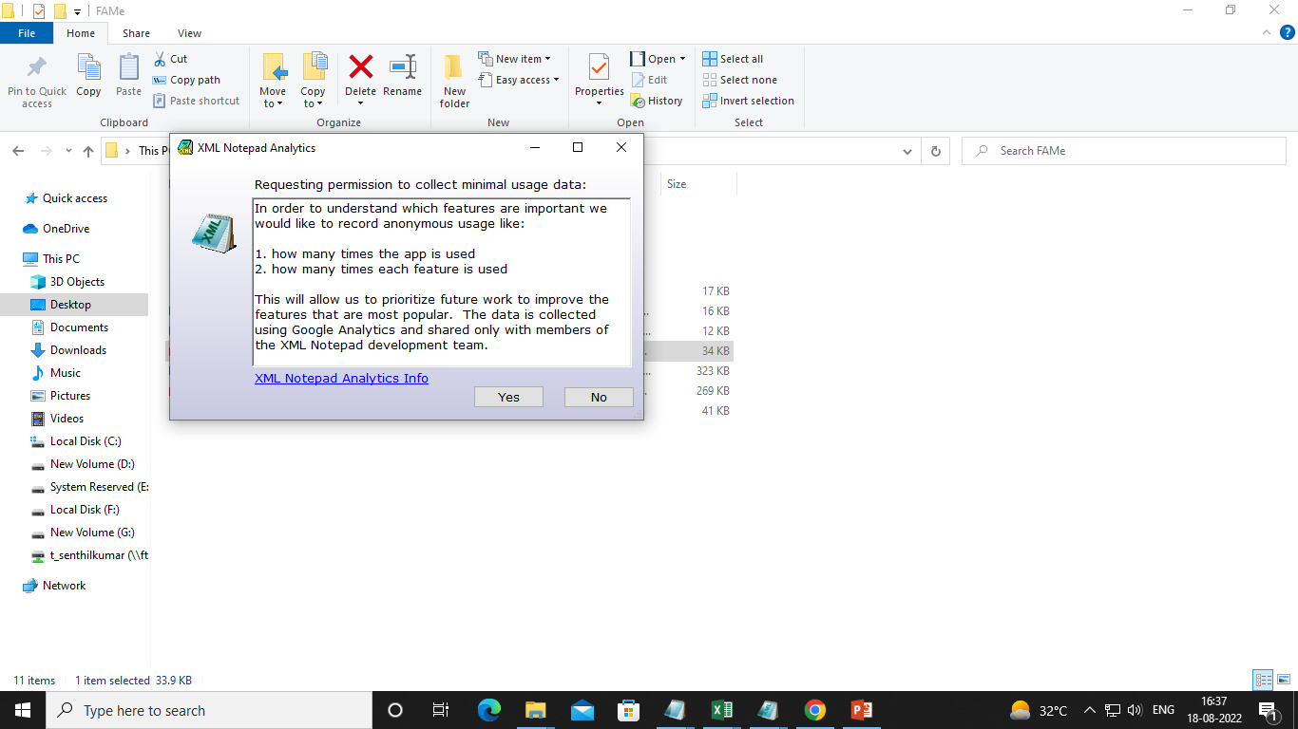

Slide 8
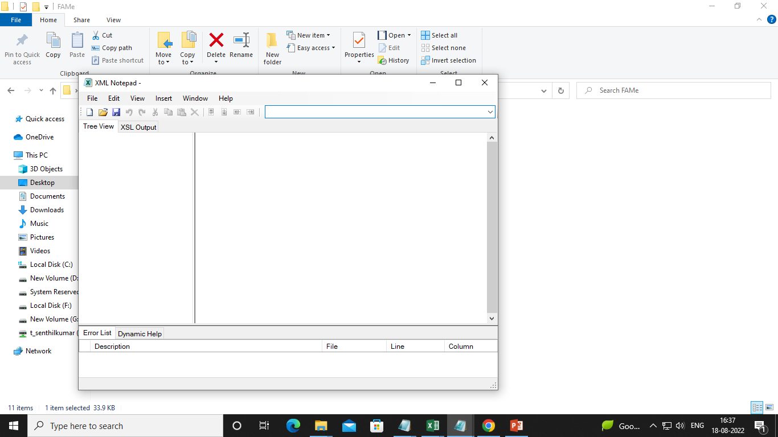

Slide 9
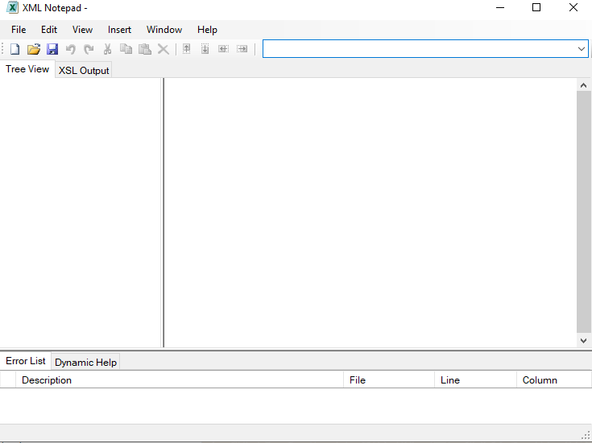

Slide 10
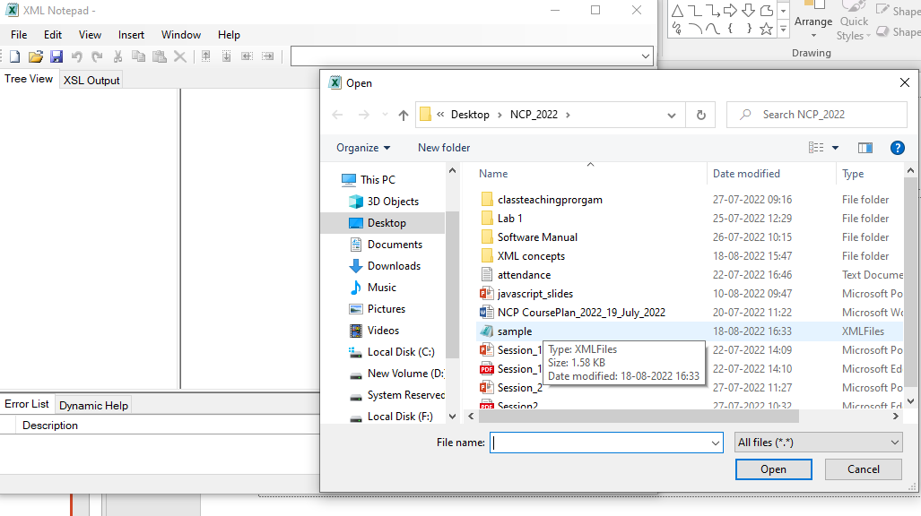

Slide 11
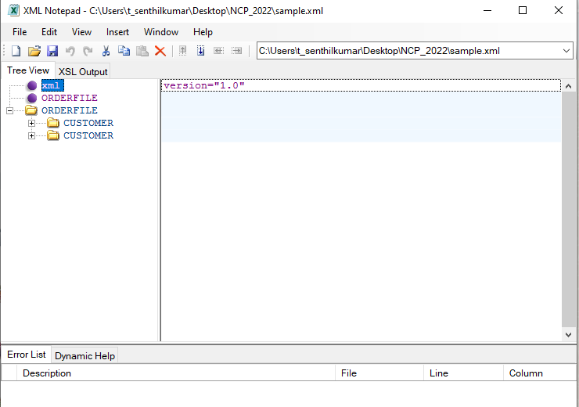

Slide 12
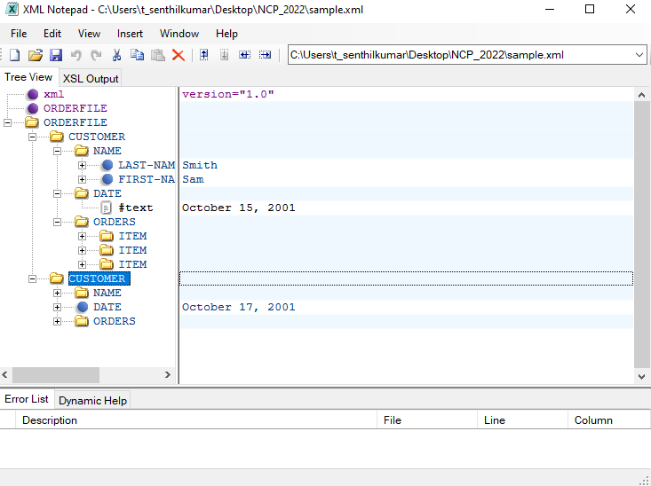

Slide 13
References
https://docs.microsoft.com/en-us/previous-versions/windows/desktop/ms762271(v=vs.85)

